Slide 1
Drone delivery Implementation Proposal COST ANALYSIS
CAPSTONE PROJECT
GROUP--A
Anjali Gupta, Ravi Ronit, Nitish Sharma, Rutika Kadam, Sachin Kulkarni, Tanmay Umathe, Rahamthulla Shaik, Hiten Kapoor, Sanjana S, Aayush Panwar, Santhosh Kumar Sridhar, Prakki Jerusha, Sanjeev Patel, Naveenkumar Rajendran, Mukul Yadav

Slide 2
Proposed Drone Delivery System
Customer places the order using Talco app.
The order placed is received by the restaurant.
Once the restaurant accepts the order, a message is sent to nearest the drone hub.
A drone is assigned with the consignment and its scheduled pick up will be given to it.
As the required Estimated time of pick up (ETP) it will reach the restaurant.
Once it pick up the order a message will be sent to the customer regarding the pick up and ETA of the food.
Once the delivery is completed, the drone will head back to the original hub. In case, it has enough battery and call from nearest restaurant for 2nd flight it can move directly to 2nd delivery.
Deliver to a predefined, or pre-identified drop off point to reduce delivery time of about 15 minutes to about 3 minutes.
The order is delivered to the location either to the customer or his/her representative.

Slide 3
Implementation Drone System
Establishment of drone master control center at every city of implementation.
All the facility centre will be controlled from here
For every 5 km there will be drone hub and a service station
Hub will be monitored by 2 master pilots.
Pickup / Delivery of Order
In case of emergency, control of all the hubs will taken from here.
In order to receive the food customer have to scan the QR code.
The order will be delivered to customer or his/her point of contact
If in case a drone is having enough battery capacity it can go for another delivery or else repeat the previous step.
After the assigned delivery it will reach the hub.

Slide 4
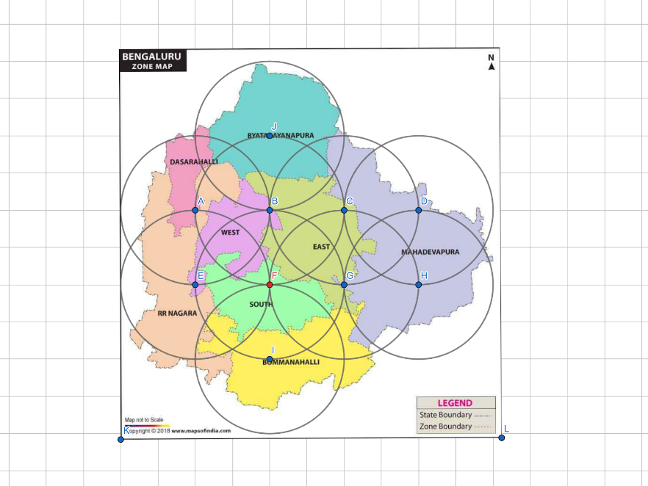

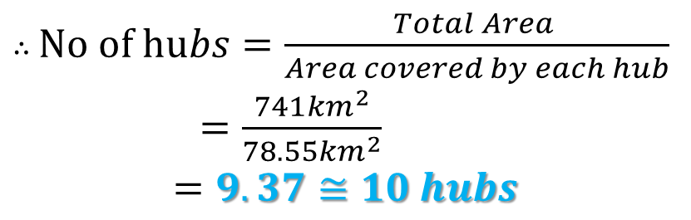
Area of Implementation
Each hub covering a radius of 5 kms
Area of Bangalore: 741sq.kms
$$A=πr^{2}$$
$$A=π5^{2}$$
$$=78.55 sq.kms$$
$∴$ $No of hubs=\frac{Total Area }{Area covered by each hub}$
$=\frac{741{km}^{2}}{78.55{km}^{2}}$ $$=9.37≅10 hubs$$
Master control Facility and HUB

Slide 5
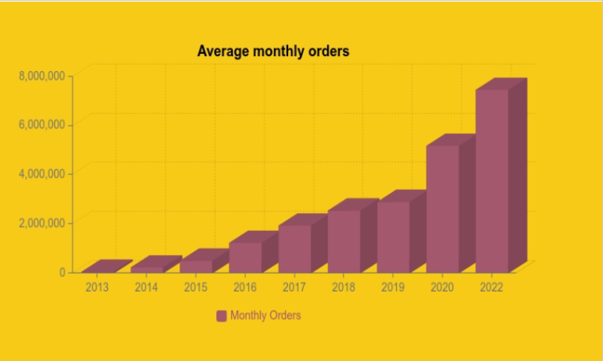
Average Monthly orders of existing system
Avg monthly orders for 2022 using straight line trend (Time series)
Year | y | x(year -mid year) | x2 | xy
2017 | 2,000,000 | -2 | 4 | -4,000,000
2018 | 2,500,000 | -1 | 1 | -2,500,000
2019 | 3,000,000 | 0 | 0 | 0
2020 | 5,200,000 | 1 | 1 | 5,200,000
2021 | 7,600,000 | 2 | 4 | 15,200,000
Total | 20,300,000 | 0 | 10 | 13,900,000
Reference: Skillovilla document
Total No of order per month for the year 2022 | 8,230,000
Bengaluru contribute 24% per month | 1,975,200
No of order per day | 65,840
70% of orders are ordered during peak hours in a day | 46,088

Slide 6
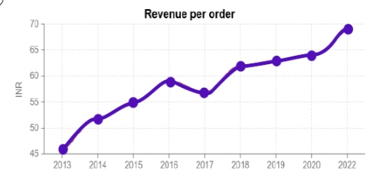
Revenue per order(RPO) of existing system
RPO for the last 5 years is as follows:
Year | RPO (Rs) | Annual growth rate (%)
2017 | 52 | 19.23
2018 | 62 | 3.23
2019 | 64 | 1.56
2020 | 65 | 7.69
2021 | 70 | 7.18
2022 | ? | ?
Reference: Skillovilla document
Annual growth rate = ((Revenue per order in current year/ Revenue per order in pervious year)-1)*100%
Revenue per order in 2022 = 70*(1+7.18%)
= Rs. 75.15
Revenue per order in 2022 = Revenue per order in 2021 *(1+Average annual growth rate)

Slide 7
Orders And Revenue Per Drone
Orders And Revenue Per Drone
No. of orders received by each customer to restaurant | 40% |  |  | 35% | 20% | 5%
Distance from restaurant to customer home | 1 | 2 | 3 | 4 | 5 | 6
Distance from Hub to Restaurant (in km) | 3 | 3 | 3 | 3 | 3 | 3
Distance from Customer home to nearest Hub | 3 | 3 | 3 | 3 | 3 | 3
Distance covered by Drone in 1 delivery | 6 | 7 | 8 | 9 | 10 | 11
Flight time (In minutes) | 30 | 30 | 30 | 30 | 30 | 30
Average speed (km/hr) | 40 | 40 | 40 | 40 | 40 | 40
Time taken to delivery order | 9 | 11 | 12 | 14 | 15 | 17
Max orders drone can deliver for each flight in 30 mins | 3 | 2 | 2 | 2 | 1 | 1
No. of deliveries in 60 mins | 6 | 4 | 4 | 4 | 2 | 2
No. of deliveries per Day | 36 | 24 | 24 | 24 | 12 | 12
No. of deliveries per Week | 252 | 168 | 168 | 168 | 84 | 84
No. of deliveries per Month | 1,008 | 672 | 672 | 672 | 336 | 336
No. of deliveries per Year | 12,096 | 8,064 | 8,064 | 8,064 | 4,032 | 4,032
Revenue per order | 100 | 100 | 100 | 100 | 100 | 100
Revenue per Day | 3,600 | 2,400 | 2,400 | 2,400 | 1,200 | 1,200
Revenue per Week | 25,200 | 16,800 | 16,800 | 16,800 | 8,400 | 8,400
Revenue per Month | 1,00,800 | 67,200 | 67,200 | 67,200 | 33,600 | 33,600
Revenue per Year | 12,09,600 | 8,06,400 | 8,06,400 | 8,06,400 | 4,03,200 | 4,03,200

Slide 8
Distribution Order received per drone
Distribution of orders received | 40% | 35% | 20% | 5%
Monthly orders | 784 | 672 | 336 | 336
Total Orders (considering distribution of Orders) | 633
Total Revenue | 63,300

Slide 9
Orders and Revenue per Hub
Orders And Revenue Per Hub
Number Of Drones | 8
Number of orders received by each cx to rest. | 40% |  |  | 35% | 20% | 5%
Distance from restaurant to customer home | 1 | 2 | 3 | 4 | 5 | 6
No. of deliveries per Day | 288 | 192 | 192 | 192 | 96 | 96
No. of deliveries per Month | 8,064 | 5,376 | 5,376 | 5,376 | 2,688 | 2,688
No. of deliveries per Year | 96,768 | 64,512 | 64,512 | 64,512 | 32,256 | 32,256
Revenue per Month | 8,06,400 | 5,37,600 | 5,37,600 | 5,37,600 | 2,68,800 | 2,68,800
Revenue per Year | 96,76,800 | 64,51,200 | 64,51,200 | 64,51,200 | 32,25,600 | 32,25,600

Slide 10
Orders and Revenue from all the Hubs
Orders And Revenue For Total Hubs(10)
Number of hubs | 10
Number of orders received by each cx to rest. | 40% |  |  | 35% | 20% | 5%
Distance from restaurant to customer home | 1 | 2 | 3 | 4 | 5 | 6
No. of deliveries per Day | 2,880 | 1,920 | 1,920 | 1,920 | 960 | 960
No. of deliveries per Month | 80,640 | 53,760 | 53,760 | 53,760 | 26,880 | 26,880
No. of deliveries per Year | 9,67,680 | 6,45,120 | 6,45,120 | 6,45,120 | 3,22,560 | 3,22,560
Revenue per Month | 80,64,000 | 53,76,000 | 53,76,000 | 53,76,000 | 26,88,000 | 26,88,000
Revenue per Year | 9,67,68,000 | 6,45,12,000 | 6,45,12,000 | 6,45,12,000 | 3,22,56,000 | 3,22,56,000

Slide 11
Comparison of Operation cost for both the system
Operational Cost for Current System
Avg Orders (per month) | 425
Avg orders per day | 15
Number of orders during peak hrs | 11
Fixed Salary(per month) | 4,000
Bonus(Per Order) | 55
total bonus per month(during peak hrs) | 605
Monthly Total Salary( Inc Bonus) | 4,605
Yearly Total Salary(per executive) | 55,260
For total executives(during peak hrs) | 23,15,39,400
Profit | 1,03,01,19,600
Profit per month | 3,43,37,320
Operational Cost for Drone Delivery System
Total Number of drones required | 80
Total Number of batteries required | 320
Hub setup(10 hubs) | 30,00,000
Master control center | 5,00,000
Drone License per master pilot | 1,000
for 80 drones | 80,000
Cost of total drones | 1,04,00,000
Drone maintenance cost | 5,20,000
Drone maintenance cost(per year) | 62,40,000
Total batteries cost | 1,66,40,000
Salary of per pilot per month | 35,000
Pilots required | 20
Salaries for 20 pilots(per month) | 7,00,000
Salaries for 20 pilots(per year) | 84,00,000
Hub maintenance per month | 50,000
Hub maintenance per month(10 hubs) | 5,00,000
Hub maintenance per year | 60,00,000
operational cost | 5,12,60,000
Profit | 1,79,65,16,000
Profit per month | 5,98,83,867

Slide 12
Projected growth for Drone Delivery System
Considering rate of growth 25% annual growth rate(source Skillovilla pdf)

Slide 13
THANK YOU

